Slide 1
Adam
Cain
Joshua
Abel
GOD
David
Caleb
Isaac
Nimrod
Noah
Joseph
Ezra
Moses
satan

Slide 2
Bible
Events
12
12
9
3
6

Slide 3
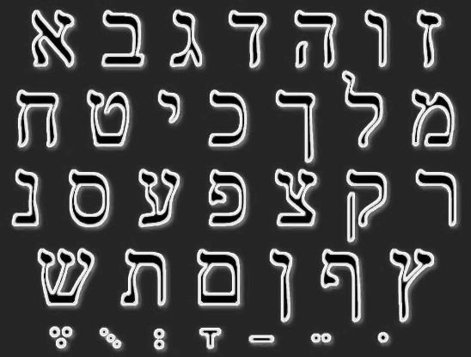


Slide 4
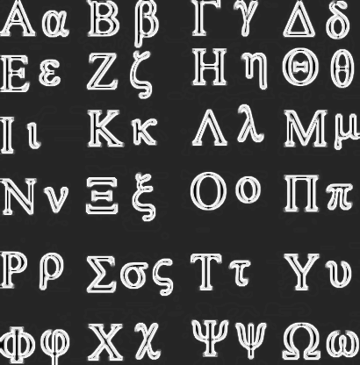


Slide 5

I Can Do All Things
Through Christ
Which Strengtheneth me. Philippians 4:13

Slide 6
PERGAMOS
imperial
PHILADELPHIA
brotherly
SMYRNA
persecuted
SARDIS
Reform
LAODICEA
EPHESUS
THYATIRA
lukewarm
apostles
jezebel

